Slide 1
Industry Strategy
Approach to Industry Strategy and Industry Value Propositions
Andrea Ricciarelli
Global Industry Lead
LSPs and Discrete Industries
2024 LEAP
September 2024

Slide 2
Westernacher Industry Clusters
1

Slide 3
“What criteria define an industry?”
“How can one differentiate between different industries?”

Slide 4
Industry definition
Industry Clusters
An industry is a group of manufacturers or businesses that produce a particular kind of goods or services.
Workers in the textile industry design, fabricate, and sell cloth.
The tourist industry includes all the commercial aspects of tourism.
The companies and activities involved in the process of producing goods for sale, especially in a factory or special area.
A: manufacturing activity as a whole
B: a distinct group of productive or profit-making enterprises
C: a department or branch of a craft, art, business, or manufacture Especially, one that employs a large personnel and capital especially in manufacturing
D: systematic labour especially for some useful purpose or the creation of something of value
Industry is the work and processes involved in collecting raw materials, and making them into products in factories.
A particular industry consists of all the people and activities involved in making a particular product or providing a particular service.

Slide 5
Westernacher Industry Clusters
Proposed Adjusted Clustering
Prio 1 industries for E2E Value Proposition Creation
Common Finance-Led, Admin ERP Scope Across All Industries*
Specific Solution Paths for the Following Industries…
INDUSTRY | SEGMENT
Chemicals & Process Industries
Agribusiness | Basic Agribusiness
Chemicals | Specialty Chemicals / Agrochemicals / Basic Chemicals
Oil & Gas | Upstream / Oil Field Services / Lubricants
Mill & Mining | Mill Discrete / Asset-Intensive Mill Process Manufacturing / Mining Service / Mining Exploitation
Life Sciences & Fast Moving Consumer Goods
Life Sciences | Life Sciences
Consumer Products | Food / Beverage / Home & Personal Care
Retail & Wholesale
Retail | Omnichannel Retail (Grocery, Drug Stores, Hard Goods, DIY, Consumer Electronics, Specialty)
Wholesale Distr. | Industrial & Construction / High Tech
Discrete Manufacturing Industries
Aerospace | Tier 3+ Suppliers excl. MRO / OEM subsidiaries and Component Service Providers
Automotive | Suppliers (simple, mid-complex) / National Sales / Mobility
High Tech Mfg | Non-Semiconductor Components
Industrial Mfg | Component Manufacturers / Automation and Controls Solutions
Consumer Products | Durable Goods
INDUSTRY | SEGMENT
Energy & Natural Resources
Mill & Mining | Mill Discrete / Asset-Intensive Mill Process Manufacturing / Mining Service / Mining Exploitation
Utilities
Utilities | Utilities
Telecommunications | Broadband Connectivity Providers and Tower Management Companies
Logistics Service Providers
Cargo Transportation and Logistics | Cargo Transportation and Logistics
Ports & Terminals | Ports & Terminals Operators
Postal Services | Postal Services
Passenger Travel and Leisure | Passenger Travel and Leisure
INDUSTRY | SEGMENT
Financial Services
Banking | Retail & Commercial / Wealth & Asset Management / FinTech & Payment Providers
Insurance | Insurance Service Providers
Public Services Industries
Healthcare | Healthcare
Higher Education and Research | North America incl. PSM / Outside NA excl. PSM functionality
Public Sector | North America State & Local institutions / State & Local Government, Public Organizations, NGOs with IFRS or local GAAP based practices
Services Industries
Engineering, Constr. & Operations (EC&O) | Construction Management / Commercial Real Estate
Media | Media Agencies / Broadcasting and Entertainment / Premium Content Publishers
Professional Services | Consulting, Audit, Tax / IT Service and BPO / Business Services incl. Facility Management / Staffing
Real Estate | Real Estate
Sport & Entertainment | Sport & Entertainment
* Finance-Led scope supports all industry segments where public cloud is supported and where the scope is focused on back office ERP. Exceptions are highly regulated industries including Healthcare and Life Sciences where private cloud is recommended but even these in some cases can be supported in public cloud based on specific customer circumstances or if regulatory requirements are met externally with customer/BTP/Partner solutions.

Slide 6
Methodology
2

Slide 7
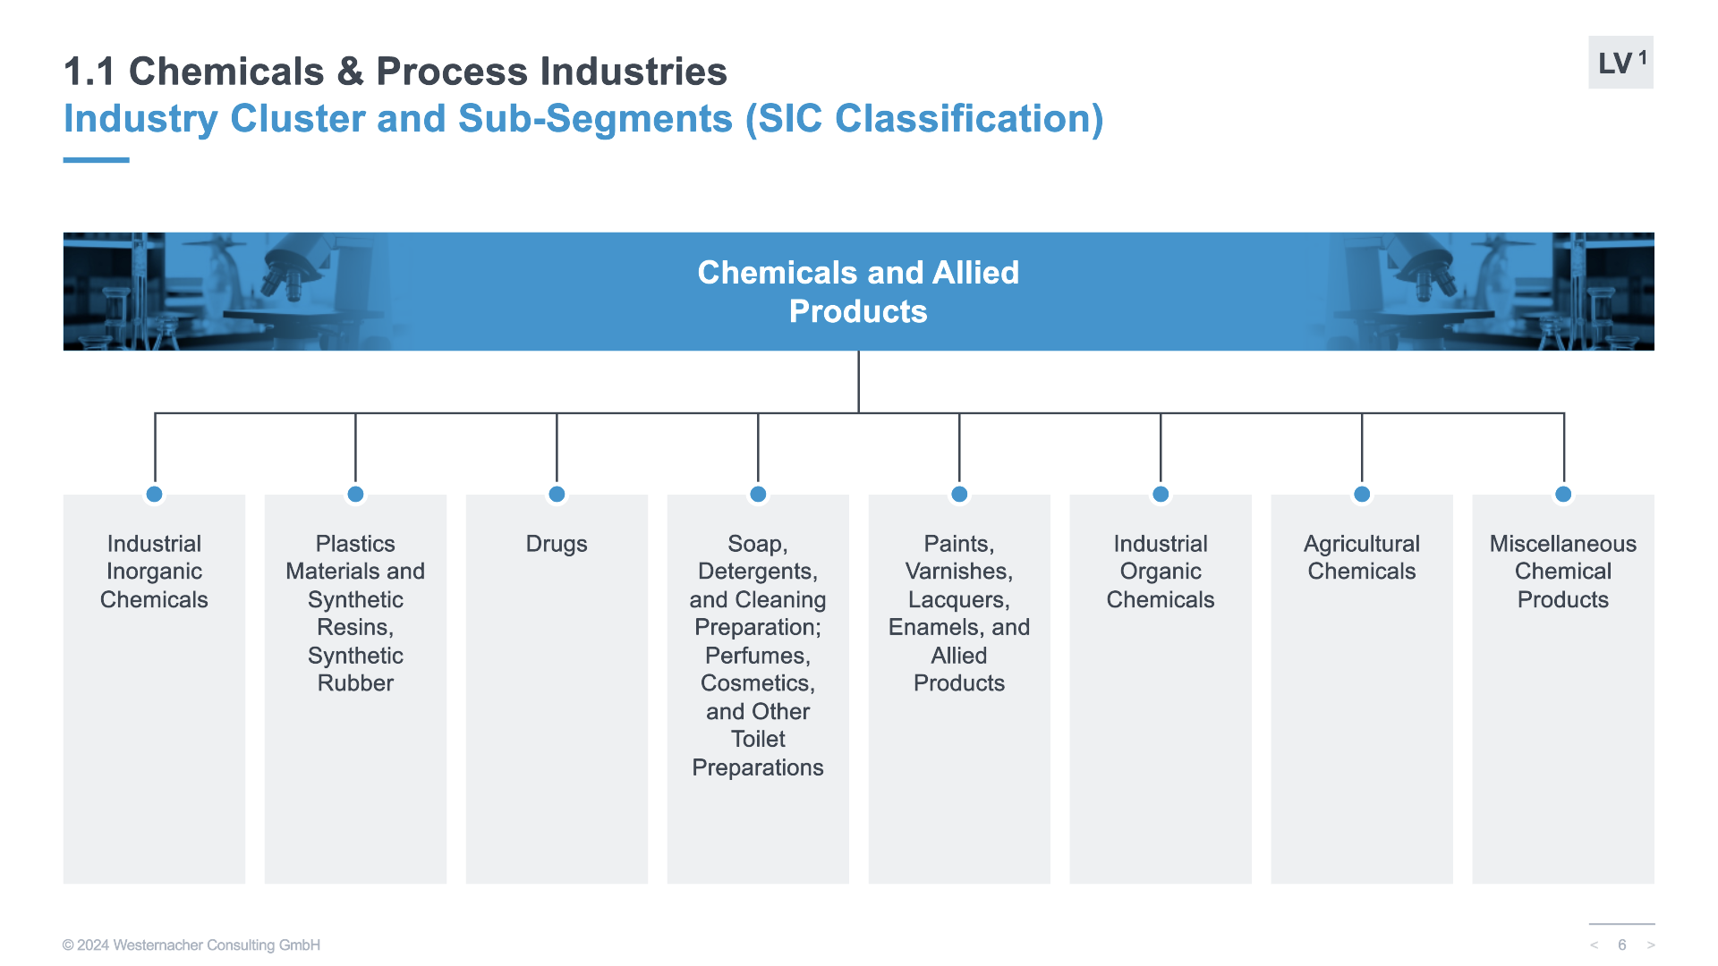
Methodology step 1
Approach to Industry Strategy
Industry Cluster and Sub-Segments
Description & Characterization of the Industry Cluster and Sub-Segments
Description
Standard Industrial Classification (SIC) Code List of Subsegments
Example of companies (not only WE customers)

Slide 8
Methodology step 1
Approach to Industry Strategy
Industry Cluster and Sub-Segments
Description & Characterization of the Industry Cluster and Sub-Segments
Description
Standard Industrial Classification (SIC) Code List of Subsegments
Example of companies (not only WE customers)

Slide 9
Methodology step 2
Approach to Industry Strategy
Industry Drivers and Benefits of a Digital Transformation
Identifying key Innovations addressing specific challenges and pain points of industry sub segments
Industry Challenges
Industry Drivers (Level 1 – Level 2)

Slide 10
Methodology step 2
Approach to Industry Strategy
Industry Drivers and Benefits of a Digital Transformation
Identifying key Innovations addressing specific challenges and pain points of industry sub segments
Industry Challenges
Industry Drivers (Level 1 – Level 2)

Slide 11
Methodology step 2
Approach to Industry Strategy
Industry Drivers and Benefits of a Digital Transformation
Identifying key Innovations addressing specific challenges and pain points of industry sub segments
Industry Challenges
Industry Drivers (Level 1 – Level 2)
Benefit for a digital transformation
E2E Value Chain and Key Innovations (Level 1 – Level 2)

Slide 12
Methodology step 2
Approach to Industry Strategy
Industry Drivers and Benefits of a Digital Transformation
Identifying key Innovations addressing specific challenges and pain points of industry sub segments
Industry Challenges
Industry Drivers (Level 1 – Level 2)
Benefit for a digital transformation
E2E Value Chain and Key Innovations (Level 1 – Level 2)

Slide 13
Methodology step 3
Approach to Industry Strategy
E2E Value Chain and Key Innovations (Level 3)
Detailed Value Chain Processes (e.g. Port Operations – Plan & Schedule, Execute & Control, Environment, Health & Safety) containing:
Sub Processes Business Challenges
Sub Processes Business Flows
SAP Solution Levers Sub Processes business capabilities
WE solutions, accelerators add-on filling the industry space
3rd party solutions

Slide 14
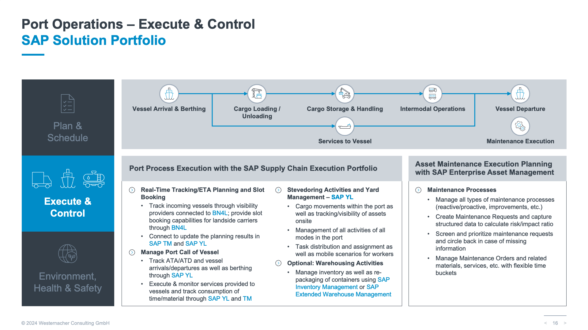
Methodology step 3
Approach to Industry Strategy
E2E Value Chain and Key Innovations (Level 3)
Detailed Value Chain Processes (e.g. Port Operations – Plan & Schedule, Execute & Control, Environment, Health & Safety) containing:
Sub Processes Business Challenges
Sub Processes Business Flows
SAP Solution Levers Sub Processes business capabilities
WE solutions, accelerators add-on filling the industry space
3rd party solutions

Slide 15
Methodology step 4
Approach to Industry Strategy
E2E Value Chain Business Processes on LeanIX/Signavio (Level 4)
Detailed E2E Value Chain mapping in LeanIX/Signavio Industry Specific environment:
Business Architecture
Solution Architecture
Process Architecture
Data Architecture
based on:
SAP Reference Architecture library
WE Value add-on processes from Customer Experience, Best Practices, Industry Know-how
WE Source to Pay
WE Plan to Fulfill
https://editor.signavio.com/p/hub-preview/en_gb/model/418ef1fe8fdb4be4b1cf97b5d4520d58
WE Lead to Cash
WE Acquire to Decommission

Slide 16
Methodology step 5
Approach to Industry Strategy
Success Stories / References
Credibility and Trust
Demonstrated Success
Industry Relevance
Customer Advocacy and Loyalty
Feedback Loop for Continuous Improvement

Slide 17
Methodology step 5
Approach to Industry Strategy
Success Stories / References
Credibility and Trust
Demonstrated Success
Industry Relevance
Customer Advocacy and Loyalty
Feedback Loop for Continuous Improvement

Slide 18
Methodology step 5
Approach to Industry Strategy
Success Stories / References
Credibility and Trust
Demonstrated Success
Industry Relevance
Customer Advocacy and Loyalty
Feedback Loop for Continuous Improvement

Slide 19
Key Take-aways
3

Slide 20
Key Milestones of the Methodology
Industry Strategy and GTM
Industry Cluster and Sub-Segments
Industry Drivers and Benefits of a Digital Transformation
E2E Value Chain and Key Innovations (Level 3)
Description & Characterization of the Industry Cluster and Sub-Segments
Description
Standard Industrial Classification (SIC) Code List of Subsegments
Example of companies (not only WE customers)
Identifying key Innovations addressing specific challenges & pain points of industry sub segments
Industry Challenges
Industry Drivers for Change (Level 1 – Level 2)
Benefit for a digital transformation
E2E Value Chain and Key Innovations (Level 1 – Level 2)
Detailed Value Chain Processes (e.g. Port Operations – Plan & Schedule, Execute & Control, Environment, Health & Safety) containing:
Sub Processes Business Challenges
Sub Processes Business Flows
SAP Solution Levers Sub Processes business capabilities
WE solutions, accelerators add-on filling the industry space 3rd party solutions
E2E Value Chain Business Processes on LeanIX/Signavio (Level 4)
Success Stories / References
Detailed E2E Value Chain mapping in LeanIX/Signavio Industry Specific environment:
Business Architecture
Solution Architecture
Process Architecture
Data Architecture
based on:
SAP Reference Architecture library
WE Value add-on processes from Customer Experience, Best Practices, Industry Know-how
👉 LeanIX/Signavio
Credibility and Trust
Demonstrated Success
Industry Relevance
Customer Advocacy and Loyalty
Feedback Loop for Continuous Improvement
WE Source to Pay
WE Plan to Fulfill
WE Lead to Cash
WE Acquire to Decommission

Slide 21
Key Take-aways
Approach to Industry Strategy and Industry Value Propositions
Combine an industry-focused go-to-market strategy and an expertise-driven internal structure organized by “Business Areas” and “Competence Centers”
Deliver a high value propositions based on a portfolio of industry-specific, innovation-focused, end-to-end offerings
Reusable industry-specific offerings with a focus on key S4-based innovations and AI
Adopt the latest SAP methodologies and tools (Activate, Cloud Centric) and Digital Transformation standards (strategy-led, Signavio/LeanIX-driven) to establish a new standard methodology
This is the starting point: a methodology outlining our approach to the industry based on our strengths.
You are a key player in driving the success of our industry. Your constant input and feedback from your customer experience are crucial for driving continuous improvement in our value proposition.

Slide 22
Thank you. Let’s work together.
Andrea Ricciarelli
Global Industry Lead
LSPs and Discrete Mfg Industries
andrea.ricciarelli@westernacher.com
linkedin.com/in/andrearicciarelli

Slide 23
Thank you!

